Slide 1
UNIT IV Statistical Data Analysis & Inference
Notes by:
Dr. Seema Gulati

Slide 2
Populations and Samples in Statistical Analysis
Population: The complete set of all individuals, objects, or events of interest in a study.
Example: All registered voters in a country.
Characteristics are called parameters (e.g., population mean μ, population proportion p).
Sample: A subset of the population selected for analysis.
Example: 1,000 voters surveyed before an election.
Characteristics are called statistics (e.g., sample mean x̄, sample proportion p̂).

Slide 3


Slide 4
Why Use Samples Instead of Populations?
Cost & Practicality: Measuring an entire population is often expensive or impossible.
Time Efficiency: Sampling allows faster data collection and analysis.
Feasibility: Some tests are destructive (e.g., crash-testing cars).
Accuracy: Proper sampling can yield highly precise estimates.

Slide 5
Sampling Methods
Probability Sampling (Random Selection)
Non-Probability Sampling (Non-Random)

Slide 6
Probability Sampling
Simple Random Sampling: Every member has an equal chance of selection.
Stratified Sampling: Population divided into subgroups (strata), then random samples are taken from each.
Cluster Sampling: Population divided into clusters (e.g., cities), and entire clusters are randomly selected.
Systematic Sampling: Selecting every k-th element from a list (e.g., every 10th person).

Slide 7
Non-Probability Sampling
Convenience Sampling: Using readily available subjects (e.g., online surveys).
Purposive Sampling: Selecting subjects based on researcher’s judgment.
Snowball Sampling: Existing participants recruit others (used in hard-to-reach populations).

Slide 8
Sampling Bias & Errors
Sampling Bias: When the sample is not representative of the population.
Example: Surveying only college students about national voting trends.
Non-Sampling Errors: Mistakes in data collection (e.g., measurement errors, response bias).
Sampling Error: Natural variation between sample statistics and population parameters.

Slide 9
Example: Population vs. Sample in Research
Aspect | Population Example | Sample Example
Definition | All adults in India | 1,000 surveyed adults
Parameter/Statistic | True average income (μ) | Sample average income (x̄ )
Data Collection | Census (rarely feasible) | Surveys, experiments

Slide 10
Statistical Modelling
Statistical modelling involves using mathematical equations to represent relationships in data. Models help:
Describe patterns in observed data
Predict future outcomes
Infer causal relationships
Statistical models can be broadly categorized into descriptive, predictive, prescriptive, and inferential models, each serving a unique purpose, from summarizing data to making predictions and recommendations.

Slide 11
Descriptive Models:
Purpose: Summarize and describe the characteristics of a dataset.
Examples:
Descriptive Statistics: Calculating measures like mean, median, mode, standard deviation, and percentiles.
Frequency Distributions and Histograms: Visualizing the distribution of data.
Scatterplots and Line Graphs: Showing relationships between variables.

Slide 12
Predictive Models:
Purpose: Predict future outcomes or values based on historical data.
Examples:
Regression Models: Predicting a continuous outcome variable (e.g., sales, temperature) based on one or more predictor variables.
Classification Models: Predicting a categorical outcome (e.g., spam/not spam, customer churn).
Time Series Analysis: Forecasting future values based on past data patterns.
Machine Learning Algorithms: Using algorithms like decision trees, random forests, and neural networks for complex predictions.

Slide 13
3. Prescriptive Models:
Purpose: Provide recommendations or guidance for decision-making.
Examples:
Optimization Models: Finding the best solution to a problem (e.g., resource allocation, scheduling).
Decision Analysis: Evaluating different options and their potential outcomes.
Simulation Models: Simulating real-world scenarios to test different strategies.

Slide 14
4. Inferential Models:
Purpose: Draw conclusions about a population based on a sample of data.
Examples:
Hypothesis Testing: Determining if there is a statistically significant difference between groups or variables.
Confidence Intervals: Estimating the range within which a population parameter is likely to fall.
Statistical Tests: Using tests like t-tests, chi-squared tests, and ANOVA to analyze data.

Slide 15
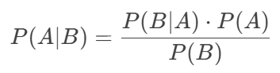
Probability Fundamentals
Probability quantifies uncertainty, ranging from 0 (impossible) to 1 (certain).
Random Variable (RV): A variable whose possible values are outcomes of a random phenomenon.
Discrete (e.g., dice rolls)
Continuous (e.g., height measurements)
Probability Rules:
Addition Rule: P(A ∪ B) = P(A) + P(B) − P(A ∩ B)
Multiplication Rule: P(A ∩ B) = P(A) × P(B|A)
Bayes’ Theorem: Updates probabilities based on new evidence:

Slide 16
Probability Distributions
Probability distributions describe how probabilities are distributed over a random variable’s values.
Discrete Distributions
Distribution | Description | Example Use
Bernoulli | Binary outcomes (success/failure) | Coin toss
Binomial | Count of successes in n trials | Number of defective items in a batch
Poisson | Counts of rare events in fixed intervals | Website visits per hour

Slide 17
Probability Distributions
Continuous Distributions
Distribution | Description | Example Use
Normal (Gaussian) | Symmetric, bell-shaped | Heights, IQ scores
Exponential | Time between events | Waiting times
Uniform | Equal probability over range | Random number generation

Slide 18
Getting started with R
1. Redirect to https://cloud.r-project.org/
2. Download and install R

Slide 19
What is R?
R is a popular programming language used for statistical computing and graphical presentation.
Its most common use is to analyze and visualize data.

Slide 20
Why Use R?
It is a great resource for data analysis, data visualization, data science and machine learning
It provides many statistical techniques (such as statistical tests, classification, clustering and data reduction)
It is easy to draw graphs in R, like pie charts, histograms, box plot, scatter plot, etc++
It works on different platforms (Windows, Mac, Linux)
It is open-source and free
It has a large community support
It has many packages (libraries of functions) that can be used to solve different problems

Slide 21
Feature | R | Python
Introduction | R is a language and environment for statistical programming which includes statistical computing and graphics. | Python is a general-purpose programming language for data analysis and scientific computing
Objective | It has many features which are useful for statistical analysis and representation. | It can be used to develop GUI applications and web applications as well as with embedded systems
Workability | It has many easy-to-use packages for performing tasks | It can easily perform matrix computation as well as optimization
Integrated development environment | Various popular R IDEs are Rstudio, RKward, R commander, etc. | Various popular Python IDEs are Spyder, Eclipse+Pydev, Atom, etc.
Libraries and packages | There are many packages and libraries like ggplot2, caret, etc. | Some essential packages and libraries are Pandas, Numpy, Scipy, etc.
Scope | It is mainly used for complex data analysis in data science. | It takes a more streamlined approach for data science projects.

Slide 22
R Syntax
To output text in R, use single or double quotes:
"Hello World!“
To output numbers, just type the number (without quotes):
5 10 25
To do simple calculations, add numbers together:
5 + 5

Slide 23
R Print Output
You can output code in R without using a print function:
"Hello World!"
A print() function is available:
print("Hello World!")
There are times you must use the print() function to output code, for example, when working with for loops:
for (x in 1:10) { print(x) }

Slide 24
Comments
Comments can be used to explain R code, and to make it more readable. It can also be used to prevent execution when testing alternative code.
Comments starts with a #. When executing code, R will ignore anything that starts with #.
# This is a comment "Hello World!“
"Hello World!" # This is a comment

Slide 25
Multiline Comments
There is no syntax in R for multiline comments.
However, we can just insert a # for each line to create multiline comments:
# This is a comment # written in # more than just one line "Hello World!"

Slide 26
Creating Variables in R
Variables are containers for storing data values.
R does not have a command for declaring a variable. A variable is created the moment you first assign a value to it. To assign a value to a variable, use the <- sign. To output (or print) the variable value, just type the variable name:
name <- "John" age <- 40 name # output "John" age # output 40
In other programming language, it is common to use = as an assignment operator. In R, we can use both = and <- as assignment operators.
However, <- is preferred in most cases because the = operator can be forbidden in some contexts in R.

Slide 27
Print / Output Variables
Compared to many other programming languages, you do not have to use a function to print/output variables in R. You can just type the name of the variable:
name <- "John Doe" name # auto-print the value of the name variable
R does have a print() function available if you want to use it.
name <- "John Doe" print(name) # print the value of the name variable

Slide 28
R Concatenate Elements
You can also concatenate, or join, two or more elements, by using the paste() function.
text <- "awesome" paste("R is", text)
You can also use , to add a variable to another variable:
text1 <- "R is" text2 <- "awesome" paste(text1, text2)

Slide 29
For numbers, the + character works as a mathematical operator:
num1 <- 5 num2 <- 10 num1 + num2
If you try to combine a string (text) and a number, R will give you an error:
num <- 5 text <- "Some text" num + text
Result:
Error in num + text : non-numeric argument to binary operator

Slide 30
R Multiple Variables
R allows you to assign the same value to multiple variables in one line:
# Assign the same value to multiple variables in one line var1 <- var2 <- var3 <- "Orange" # Print variable values var1 var2 var3

Slide 31
R Variable Names (Identifiers)
A variable can have a short name (like x and y) or a more descriptive name (age, carname, total_volume). Rules for R variables are:
A variable name must start with a letter and can be a combination of letters, digits, period(.)
and underscore(_). If it starts with period(.), it cannot be followed by a digit.
A variable name cannot start with a number or underscore (_)
Variable names are case-sensitive (age, Age and AGE are three different variables)
Reserved words cannot be used as variables (TRUE, FALSE, NULL, if...)

Slide 32
# Legal variable names: myvar <- "John" my_var <- "John" myVar <- "John" MYVAR <- "John" myvar2 <- "John" .myvar <- "John" # Illegal variable names: 2myvar <- "John" my-var <- "John" my var <- "John" _my_var <- "John" my_v@ar <- "John" TRUE <- "John"

Slide 33
Basic Data Types
numeric - (10.5, 55, 787)
integer - (1L, 55L, 100L, where the letter "L" declares this as an integer)
complex - (9 + 3i, where "i" is the imaginary part)
character (string) - ("k", "R is exciting", "FALSE", "11.5")
logical (boolean) - (TRUE or FALSE)

Slide 34
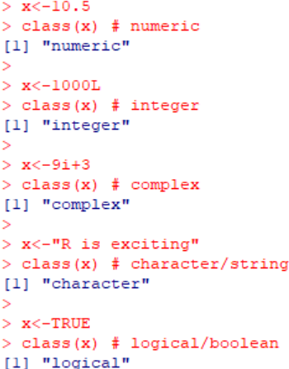
x <- 10.5 class(x) # numeric x <- 1000L class(x) # integer x <- 9i + 3 class(x) # complex x <- "R is exciting" class(x) # character/string x <- TRUE class(x) # logical/boolean

Slide 35
Simple Math
In R, you can use operators to perform common mathematical operations on numbers.
The + operator is used to add together two values:
10+5
And the - operator is used for subtraction:
10-5

Slide 36
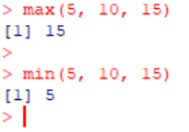
Built-in Math Functions
R also has many built-in math functions that allows you to perform mathematical tasks on numbers.
For example, the min() and max() functions can be used to find the lowest or highest number in a set:
max(5, 10, 15) min(5, 10, 15)

Slide 37
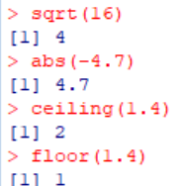
sqrt(): function returns the square root of a number:
sqrt(16)
abs(): function returns the absolute (positive) value of a number:
abs(-4.7)
ceiling() and floor(): The ceiling() function rounds a number upwards to its nearest integer, and the floor() function rounds a number downwards to its nearest integer, and returns the result:
ceiling(1.4) floor(1.4)

Slide 38
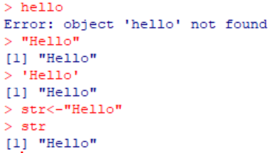
String Literals
Strings are used for storing text.
A string is surrounded by either single quotation marks, or double quotation marks:
"hello" is the same as 'hello’:
Assigning a string to a variable is done with the variable followed by the <- operator and the string:

Slide 39
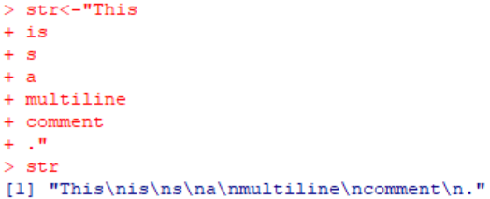
Multiline Strings
You can assign a multiline string to a variable like this:

Slide 40
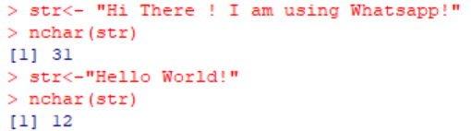
String Length
There are many useful string functions in R.
For example, to find the number of characters in a string, use the nchar() function:

Slide 41
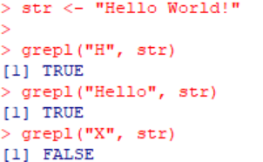
Check a String
Use the grepl() function to check if a character or a sequence of characters are present in a string:

Slide 42
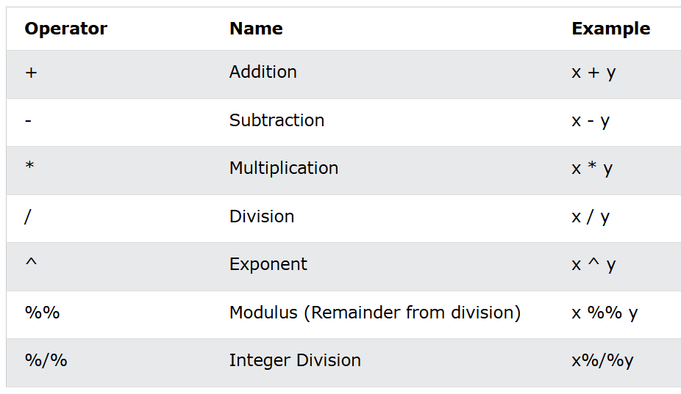
R Arithmetic Operators

Slide 43
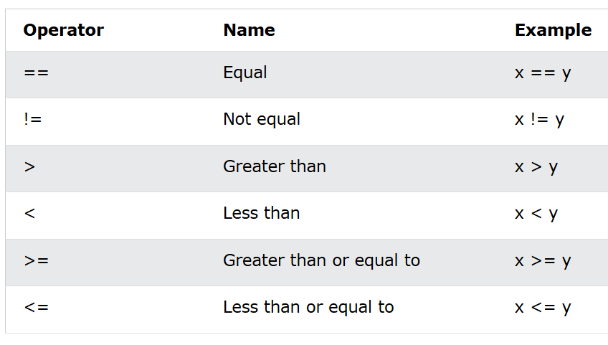
R Comparison Operators

Slide 44
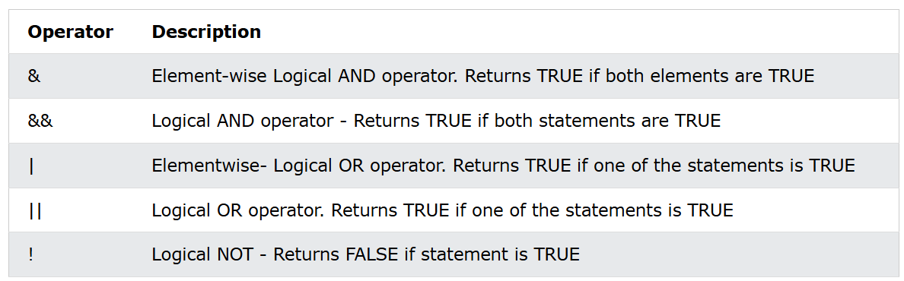
R Logical Operators

Slide 45
Assignment Operators
= (Simple Assignment)
<- (Leftward Assignment)
-> (Rightward Assignment)

Slide 46
my_var <- 3 my_var # print my_var my_var <<- 3 my_var # print my_var 3 -> my_var my_var # print my_var 3 ->> my_var my_var # print my_var
<<- is a global assigner. It is also possible to turn the direction of the assignment operator.
x <- 3 is equal to 3 -> x

Slide 47
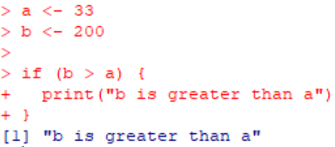
The if Statement
An "if statement" is written with the if keyword, and it is used to specify a block of code to be executed if a condition is TRUE:
a <- 33 b <- 200 if (b > a) { print("b is greater than a") }

Slide 48
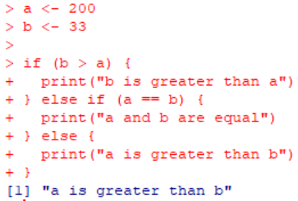
If Else
a <- 200 b <- 33 if (b > a) { print("b is greater than a") } else if (a == b) { print("a and b are equal") } else { print("a is greater than b") }

Slide 49
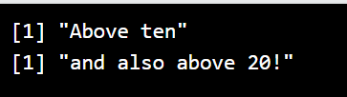
Nested If Statements
x <- 41 if (x > 10) { print("Above ten") if (x > 20) { print("and also above 20!") } else { print("but not above 20.") } } else { print("below 10.") }

Slide 50
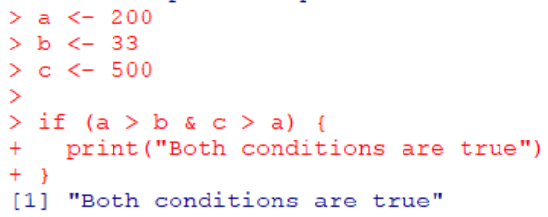
AND
The & symbol (and) is a logical operator, and is used to combine conditional statements:
a <- 200 b <- 33 c <- 500 if (a > b & c > a) { print("Both conditions are true") }

Slide 51
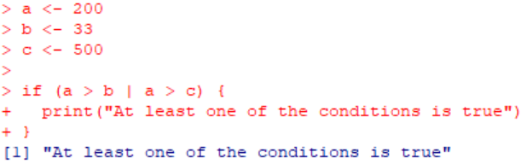
OR
The | symbol (or) is a logical operator, and is used to combine conditional statements.

Slide 52
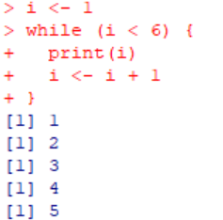
R While Loop
With the while loop we can execute a set of statements as long as a condition is TRUE:

Slide 53
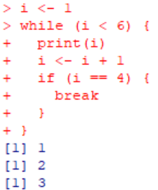
Break
With the break statement, we can stop the loop even if the while condition is TRUE.
The loop stops at 3 because we have chosen to finish the loop by using the break statement when i is equal to 4 (i == 4).

Slide 54
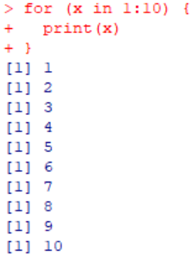
For Loop
A for loop is used for iterating over a sequence.

Slide 55
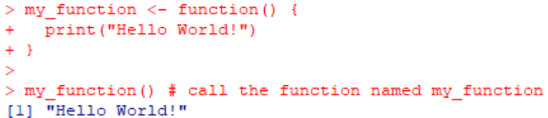
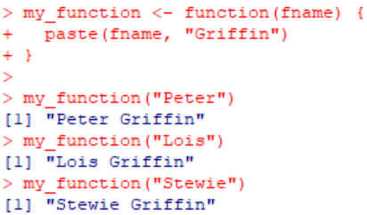
Functions in R
To create a function, use the
function() keyword:
Arguments are specified after the function
name, inside the parentheses. You can add as
many arguments as you want, just separate
them with a comma.

Slide 56
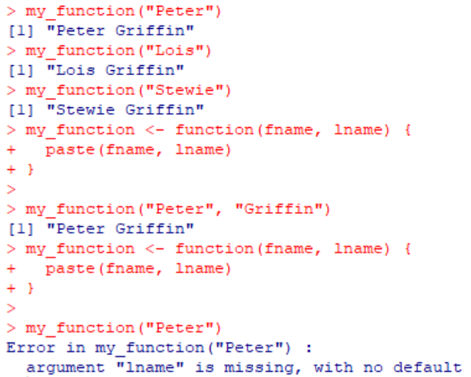

Slide 57
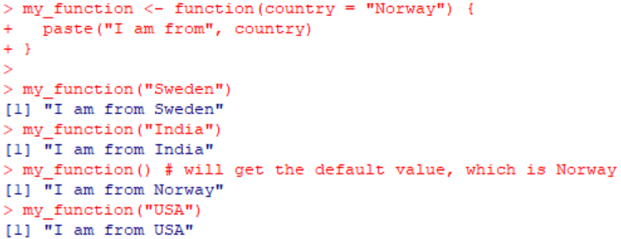
Default Parameter Value

Slide 58
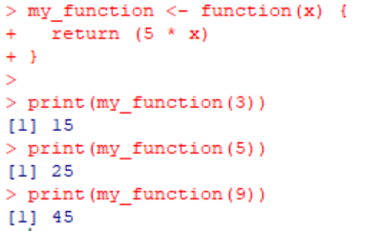
Return Values

Slide 59
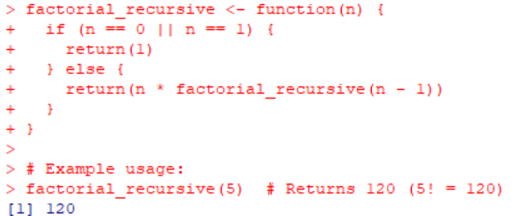
R recursive factorial function

Slide 60
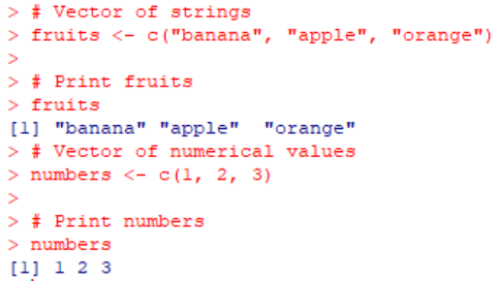
Vectors in R
A vector is simply a list of items that are of the same type.
To combine the list of items into a vector, use the c() function and separate the items by a comma.

Slide 61
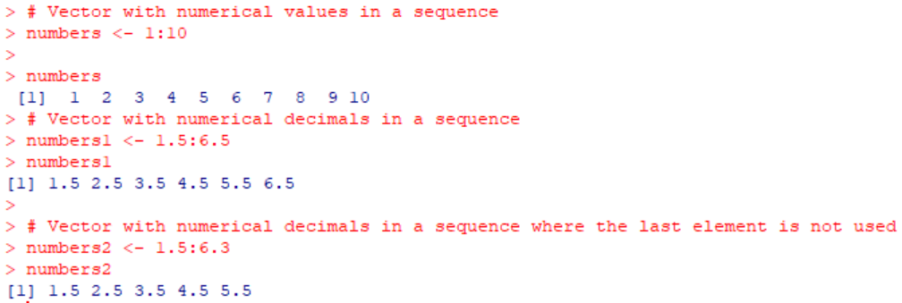
To create a vector with numerical values in a sequence, use the : operator:

Slide 62
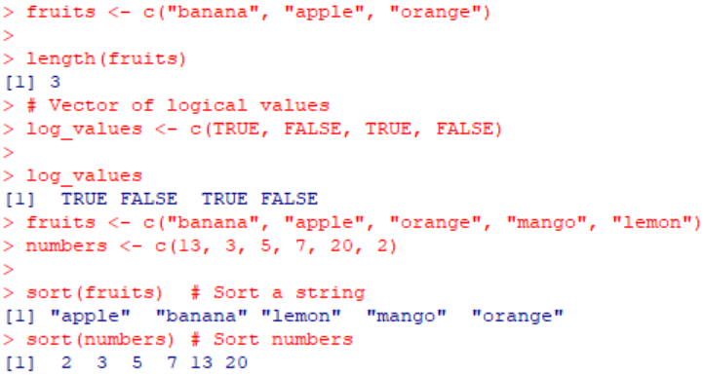

Slide 63
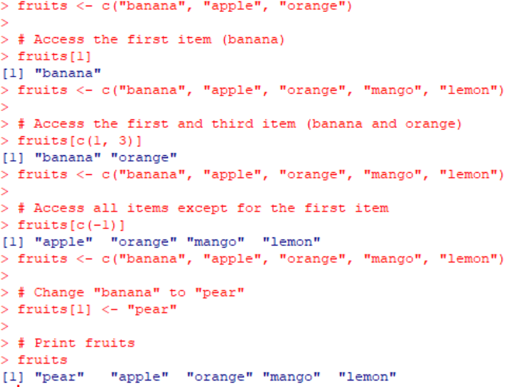
Accessing Elements

Slide 64
R Lists
A list in R can contain many different data types inside it. A list is a collection of data which is ordered and changeable.
# List of strings thislist <- list("apple", "banana", "cherry") # Print the list thislist
thislist[1]
thislist[1] <- "blackcurrant" # Print the updated list thislist

Slide 65
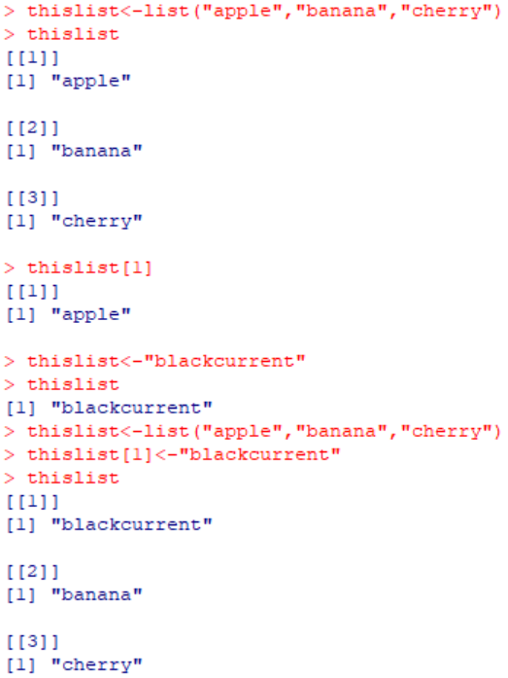

Slide 66
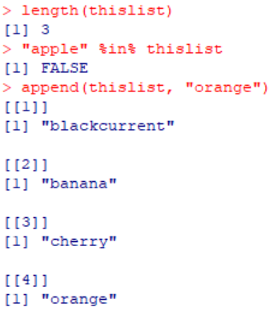
Length of List

Slide 67
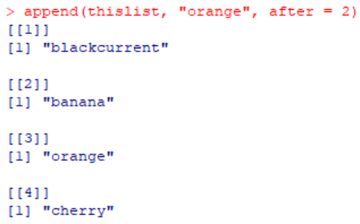
To add an item to the right of a specified index, add "after=index number" in the append() function:

Slide 68
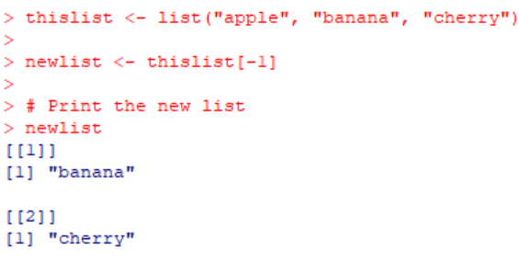
Remove List Items The following example creates a new, updated list without an "apple" item:

Slide 69
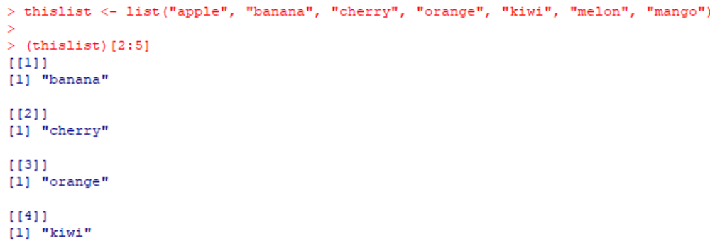
Range of Indexes

Slide 70
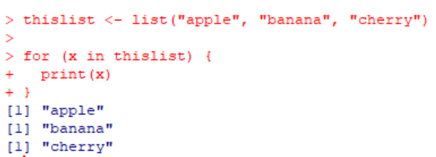
Loop Through a List

Slide 71
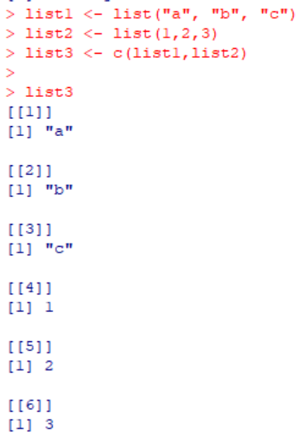
Join Lists
There are several ways to join, or concatenate, two or more lists in R.
The most common way is to use the c() function, which combines two elements together:

Slide 72
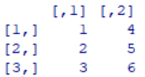
R Matrices
A matrix is a two-dimensional data set with columns and rows.
A column is a vertical representation of data, while a row is a horizontal representation of data.
A matrix can be created with the matrix() function. Specify the nrow and ncol parameters to get the amount of rows and columns:
# Create a matrix thismatrix <- matrix(c(1,2,3,4,5,6), nrow = 3, ncol = 2) # Print the matrix thismatrix

Slide 73
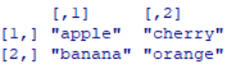
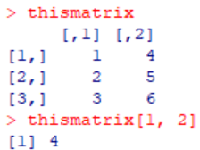
Creating a string type matrix
thismatrix <- matrix(c("apple", "banana", "cherry", "orange"), nrow = 2, ncol = 2) thismatrix
You can access the items by using [ ] brackets. The first number "1" in the bracket specifies the row-position, while the second number "2" specifies the column-position:

Slide 74
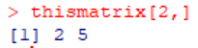
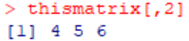
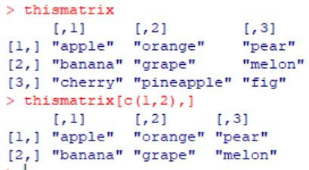
The whole row can be accessed if you specify a comma after the number in the bracket:
The whole column can be accessed if you specify a comma before the number in the bracket:
More than one row can be accessed if you use the c() function:
thismatrix <- matrix(c("apple", "banana", "cherry", "orange", "grape", "pineapple", "pear", "melon", "fig"), nrow = 3, ncol = 3)
thismatrix[c(1,2),]

Slide 75
Arrays
Compared to matrices, arrays can have more than two dimensions.
We can use the array() function to create an array, and the dim parameter to specify the dimensions.

Slide 76
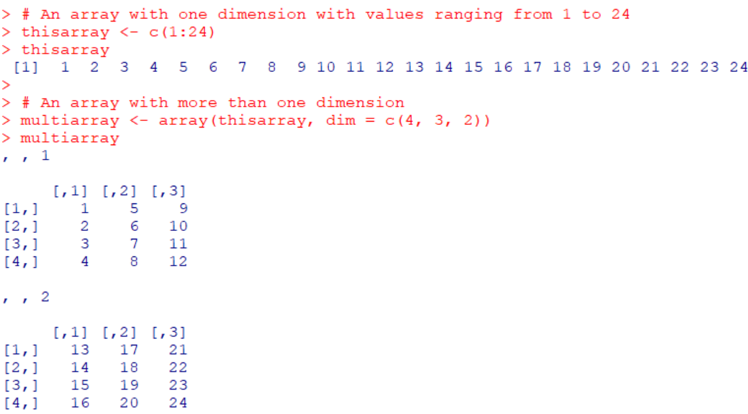

Slide 77
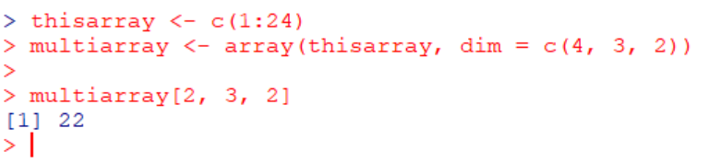
Accessing Arrays
You can access the array elements by referring to the index position. You can use the [] brackets to access the desired elements from an array:

Slide 78
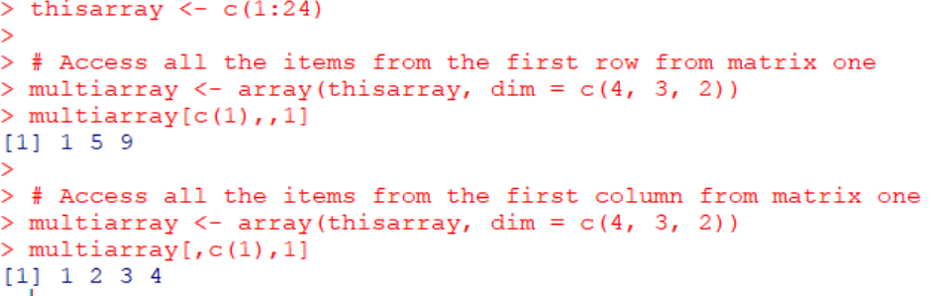
You can also access the whole row or column from a matrix in an array, by using the c() function:

Slide 79
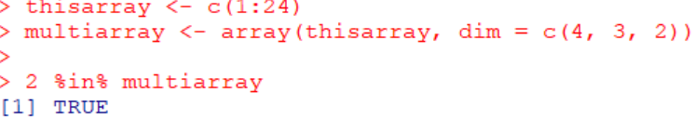
Check if an Item Exists
To find out if a specified item is present in an array, use the %in% operator:

Slide 80
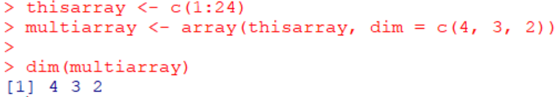
Number of Rows and Columns
Use the dim() function to find the amount of rows and columns in an array:

Slide 81
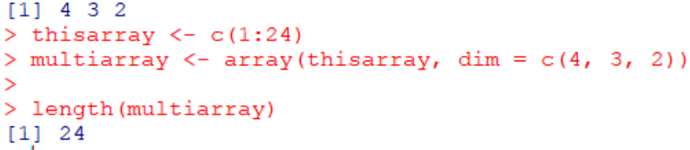
Array Length
Use the length() function to find the dimension of an array:

Slide 82
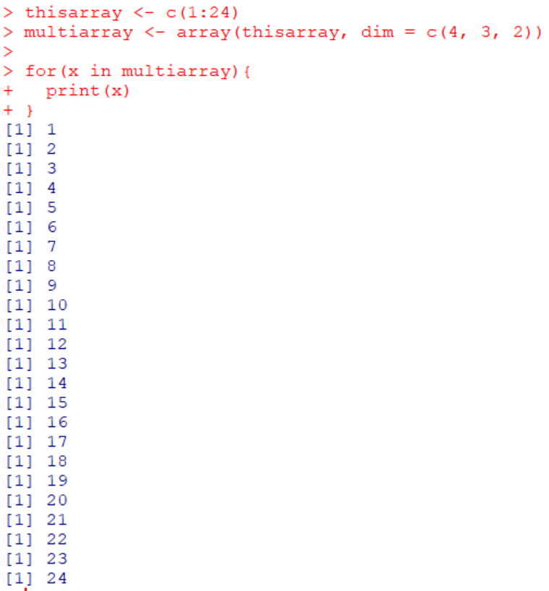
Loop Through an Array

Slide 83
R Data Frames
Data Frames are data displayed in a format as a table.
Data Frames can have different types of data inside it. While the first column can be character, the second and third can be numeric or logical. However, each column should have the same type of data.
Use the data.frame() function to create a data frame:
Notes:
A data frame in R is a two-dimensional, tabular data structure used to store data in the form of rows and columns, where each column can contain data of different types (such as numeric, character, or logical data). It is one of the most commonly used data structures in R for data analysis because it can hold a variety of data types and is easy to manipulate.
Here are some key features of data frames in R:
1. Structure:
Rows: Represent observations or instances in the dataset.
Columns: Represent variables or features associated with the observations.

Slide 84
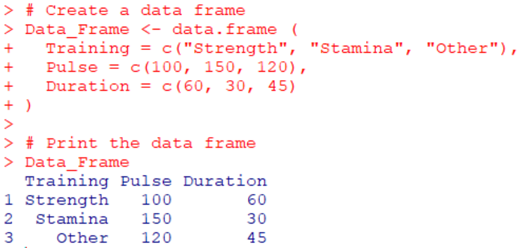

Slide 85

Summarize the Data
Use the summary() function to summarize the data from a Data Frame:

Slide 86

Access Items in Frames
We can use single brackets [ ], double brackets [[ ]] or $ to access columns from a data frame:

Slide 87

Add Rows
Use the rbind() function to add new rows in a Data Frame:

Slide 88

Add Columns
Use the cbind() function to add new columns in a Data Frame:

Slide 89

Remove Rows and Columns
Use the c() function to remove rows and columns in a Data Frame:

Slide 90

Amount of Rows and Columns
Use the dim() function to find the amount of rows and columns in a Data Frame:

Slide 91

Data Frame Length
Use the length() function to find the number of columns in a Data Frame (similar to ncol()):

Slide 92
Combining Data Frames
Use the rbind() function to combine two or more data frames in R vertically:
Data_Frame1 <- data.frame ( Training = c("Strength", "Stamina", "Other"), Pulse = c(100, 150, 120), Duration = c(60, 30, 45) ) Data_Frame2 <- data.frame ( Training = c("Stamina", "Stamina", "Strength"), Pulse = c(140, 150, 160), Duration = c(30, 30, 20) ) New_Data_Frame <- rbind(Data_Frame1, Data_Frame2) New_Data_Frame

Slide 93


Slide 94
Use the cbind() function to combine two or more data frames in R horizontally:
Data_Frame3 <- data.frame ( Training = c("Strength", "Stamina", "Other"), Pulse = c(100, 150, 120), Duration = c(60, 30, 45) ) Data_Frame4 <- data.frame ( Steps = c(3000, 6000, 2000), Calories = c(300, 400, 300) ) New_Data_Frame1 <- cbind(Data_Frame3, Data_Frame4) New_Data_Frame1

Slide 95


Slide 96
Factors
Factors are used to categorize data. Examples of factors are:
Demography: Male/Female
Music: Rock, Pop, Classic, Jazz
Training: Strength, Stamina
To create a factor, use the factor() function and add a vector as argument:
# Create a factor music_genre <- factor(c("Jazz", "Rock", "Classic", "Classic", "Pop", "Jazz", "Rock", "Jazz")) # Print the factor music_genre

Slide 97


Slide 98
From the example above that you can see the factor has four levels (categories): Classic, Jazz, Pop and Rock.
To only print the levels, use the levels() function:
music_genre <-factor(c ("Jazz", "Rock", "Classic", "Classic", "Pop", "Jazz", "Rock", "Jazz")) levels(music_genre)

Slide 99
Set the levels, by adding the levels argument inside the factor() function:
music_genre <- factor(c("Jazz", "Rock", "Classic", "Classic", "Pop", "Jazz", "Rock", "Jazz"), levels = c("Classic", "Jazz", "Pop", "Rock", "Other")) levels(music_genre)

Slide 100

Factor Length
Use the length() function to find out how many items there are in the factor:
music_genre <- factor(c("Jazz", "Rock", "Classic", "Classic", "Pop", "Jazz", "Rock", "Jazz")) length(music_genre)

Slide 101

Access Factors
To access the items in a factor, refer to the index number, using [] brackets:

Slide 102


Change Item Value
To change the value of a specific item, refer to the index number:
You cannot change the value of a specific item if it is not already specified in the factor.

Slide 103

However, if you have already specified it inside the levels argument, it will work:
music_genre <- factor(c("Jazz", "Rock", "Classic", "Classic", "Pop", "Jazz", "Rock", "Jazz"), levels = c("Classic", "Jazz", "Pop", "Rock", "Opera")) music_genre[3] <- "Opera" music_genre[3]

Slide 104
R Graphics

Slide 105
R Plotting
The plot() function is used to draw points (markers) in a diagram.
The function takes parameters for specifying points in the diagram.
Parameter 1 specifies points on the x-axis.
Parameter 2 specifies points on the y-axis.
The plot() function to plot two numbers against each other:

Slide 106

Example
Draw one point in the diagram, at position (1) and position (3):
plot(1, 3)

Slide 107

To draw more points, use vectors:
Draw two points in the diagram, one at position (1, 3) and one in position (8, 10):
plot(c(1, 8), c(3, 10))

Slide 108

Multiple Points
We can plot as many points we need, but the number of points in both axis should be the same:

Slide 109

For better organization, when you have many values, it is better to use variables:
x <- c(1, 2, 3, 4, 5) y <- c(3, 7, 8, 9, 12) plot(x, y)

Slide 110

Sequences of Points
plot(1:10)

Slide 111

Draw a Line
The plot() function also takes a type parameter with the value l to draw a line to connect all the points in the diagram:
Plot(1:10,type=‘l’)

Slide 112
Plot Labels
The plot() function also accept other parameters, such as main, xlab and ylab if you want to customize the graph with a main title and different labels for the x and y-axis:
Example
plot(1:10, main="My Graph", xlab="The x-axis", ylab="The y axis")

Slide 113


Slide 114
Graph Appearance
There are many other parameters you can use to change the appearance of the points.
Colors
Use col="color" to add a color to the points:
Example
plot(1:10, col="red")
Size
Use cex=number to change the size of the points (1 is default, while 0.5 means 50% smaller, and 2 means 100% larger):
Example
plot(1:10, cex=2)

Slide 115



Slide 116

plot(1:10, col="red", cex=2)

Slide 117

Point Shape
Use pch with a value from 0 to 25 to change the point shape format:
plot(1:10, pch=25, cex=2)

Slide 118

The values of the pch parameter range from 0 to 25, which means that we can choose up to 26 different types of point shapes:

Slide 119

R Line
Line Graphs
A line graph has a line that connects all the points in a diagram.
To create a line, use the plot() function and add the type parameter with a value of "l":
plot(1:10, type="l")

Slide 120

Line Color
The line color is black by default. To change the color, use the col parameter:
Example
plot(1:10, type="l", col="blue")

Slide 121

Line Width
To change the width of the line, use the lwd parameter (1 is default, while 0.5 means 50% smaller, and 2 means 100% larger):
plot(1:10, type="l", lwd=2)

Slide 122

Line Styles
The line is solid by default. Use the lty parameter with a value from 0 to 6 to specify the line format.
For example, lty=3 will display a dotted line instead of a solid line:
plot(1:10, type="l", lwd=5, lty=3)

Slide 123
Available parameter values for lty:
0 removes the line
1 displays a solid line
2 displays a dashed line
3 displays a dotted line
4 displays a "dot dashed" line
5 displays a "long dashed" line
6 displays a "two dashed" line

Slide 124

Multiple Lines
To display more than one line in a graph, use the plot() function together with the lines() function:
line1 <- c(1,2,3,4,5,10)
line2 <- c(2,5,7,8,9,10)
plot(line1, type = "l", col = "blue")
lines(line2, type="l", col = "red")

Slide 125
R Scatter Plot
A "scatter plot" is a type of plot used to display the relationship between two numerical variables, and plots one dot for each observation.
It needs two vectors of same length, one for the x-axis (horizontal) and one for the y-axis (vertical):
x <- c(5,7,8,7,2,2,9,4,11,12,9,6)
y <- c(99,86,87,88,111,103,87,94,78,77,85,86)
plot(x, y)

Slide 126


Slide 127
The result of 12 cars passing by
x <- c(5,7,8,7,2,2,9,4,11,12,9,6) #Car Age
y <- c(99,86,87,88,111,103,87,94,78,77,85,86) #Car Speed
plot(x, y, main="Observation of Cars", xlab="Car age", ylab="Car speed")

Slide 128


Slide 129
Inferences
The x-axis shows how old the car is.
The y-axis shows the speed of the car when it passes.
Are there any relationships between the observations?
It seems that the newer the car, the faster it drives, but that could be a coincidence, after all we only registered 12 cars.

Slide 130
Compare Plots
There seems to be a relationship between the car speed and age, but what if we plot the observations from another day as well? Will the scatter plot tell us something else?
To compare the plot with another plot, use the points() function:
x1 <- c(5,7,8,7,2,2,9,4,11,12,9,6) # day one, the age and speed of 12 cars
y1 <- c(99,86,87,88,111,103,87,94,78,77,85,86)
x2 <- c(2,2,8,1,15,8,12,9,7,3,11,4,7,14,12) # day two, the age and speed of 15 cars
y2 <- c(100,105,84,105,90,99,90,95,94,100,79,112,91,80,85)
plot(x1, y1, main="Observation of Cars", xlab="Car age", ylab="Car speed", col="red", cex=2)
points(x2, y2, col="blue", cex=2)

Slide 131


Slide 132

R Pie Charts
A pie chart is a circular graphical view of data.
Use the pie() function to draw pie charts:
Example
# Create a vector of pies
x <- c(10,20,30,40)
# Display the pie chart
pie(x)

Slide 133
The pie chart draws one pie for each value in the vector (in this case, 10, 20, 30, 40).
By default, the plotting of the first pie starts from the x-axis and move counterclockwise.
The size of each pie is determined by comparing the value with all the other values, by using the formula:
The value divided by the sum of all values: x/sum(x)

Slide 134
Start Angle
To change the start angle of the pie chart with the init.angle parameter.
The value of init.angle is defined with angle in degrees, where default angle is 0.
# Create a vector of pies x <- c(10,20,30,40) # Display the pie chart and start the first pie at 90 degrees pie(x, init.angle = 90)

Slide 135


Slide 136
Labels and Header
Use the label parameter to add a label to the pie chart, and use the main parameter to add a header:
Example
# Create a vector of pies
x <- c(10,20,30,40)
# Create a vector of labels
mylabel <- c("Apples", "Bananas", "Cherries", "Dates")
# Display the pie chart with labels
pie(x, label = mylabel, main = "Fruits")

Slide 137


Slide 138
Colors
You can add a color to each pie with the col parameter:
Example
# Create a vector of colors
colors <- c("blue", "yellow", "green", "black")
# Display the pie chart with colors
pie(x, label = mylabel, main = "Fruits", col = colors)

Slide 139


Slide 140
Legend
To add a list of explanation for each pie, use the legend() function:
Example:
# Create a vector of labels mylabel <- c("Apples", "Bananas", "Cherries", "Dates") # Create a vector of colors colors <- c("blue", "yellow", "green", "black") # Display the pie chart with colors pie(x, label = mylabel, main = "Pie Chart", col = colors) # Display the explanation box legend("bottomright", mylabel, fill = colors)

Slide 141

The legend can be positioned as either:
bottomright, bottom, bottomleft, left, topleft, top, topright, right, center

Slide 142

R Bar Charts
A bar chart uses rectangular bars to visualize data. Bar charts can be displayed horizontally or vertically. The height or length of the bars are proportional to the values they represent.
Use the barplot() function to draw a vertical bar chart:
# x-axis values x <- c("A", "B", "C", "D") # y-axis values y <- c(2, 4, 6, 8) barplot(y, names.arg = x)

Slide 143
In the above example:
The x variable represents values in the x-axis (A,B,C,D)
The y variable represents values in the y-axis (2,4,6,8)
Then we use the barplot() function to create a bar chart of the values
names.arg defines the names of each observation in the x-axis

Slide 144

Bar Color
Use the col parameter to change the color of the bars:
x <- c("A", "B", "C", "D")
y <- c(2, 4, 6, 8)
barplot(y, names.arg = x, col = "red")

Slide 145

Density / Bar Texture
To change the bar texture, use the density parameter:
x <- c("A", "B", "C", "D") y <- c(2, 4, 6, 8) barplot(y, names.arg = x, density = 10)

Slide 146

Bar Width
Use the width parameter to change the width of the bars:
Example:
x <- c("A", "B", "C", "D") y <- c(2, 4, 6, 8) barplot(y, names.arg = x, width = c(1,2,3,4))

Slide 147

Horizontal Bars
If you want the bars to be displayed horizontally instead of vertically, use horiz=TRUE:
x <- c("A", "B", "C", "D") y <- c(2, 4, 6, 8) barplot(y, names.arg = x, horiz = TRUE)

Slide 148
R Statistics

Slide 149
Statistics Introduction
Statistics is the science of analysing, reviewing and concluding data.
Some basic statistical numbers include:
Mean, median and mode
Minimum and maximum value
Percentiles
Variance and Standard Deviation
Covariance and Correlation
Probability distributions
The R language was developed by two statisticians. It has many built-in functionalities, in addition to libraries for the exact purpose of statistical analysis.

Slide 150
R Data Set
A data set is a collection of data, often presented in a table.
There is a popular built-in data set in R called "mtcars" (Motor Trend Car Road Tests), which is retrieved from the 1974 Motor Trend US Magazine.
Example:
# Print the mtcars data set mtcars
OUTPUT: next slide

Slide 151


Slide 152

Information About the Data Set
The question mark (?) to get information about the mtcars data set:
# Use the question mark to get information about the data set ?mtcars
Redirects to URL:
http://127.0.0.1:17504/library/datasets/html/mtcars.html

Slide 153
Get Information
Use the dim() function to find the dimensions of the data set, and the names() function to view the names of the variables:
Data_Cars <- mtcars # create a variable of the mtcars data set for better organization # Use dim() to find the dimension of the data set dim(Data_Cars) # Use names() to find the names of the variables from the data set names(Data_Cars)

Slide 154

Use the rownames() function to get the name of each row in the first column, which is the name of each car:
Data_Cars <- mtcars rownames(Data_Cars)

Slide 155
From the examples above, we have found out that the data set has 32 observations (Mazda RX4, Mazda RX4 Wag, Datsun 710, etc) and 11 variables (mpg, cyl, disp, etc).
A variable is defined as something that can be measured or counted.
A brief explanation of the variables from the mtcars data set:
Variable Name | Description
mpg | Miles/(US) Gallon
cyl | Number of cylinders
disp | Displacement
hp | Gross horsepower
drat | Rear axle ratio
wt | Weight (1000 lbs)
qsec | 1/4 mile time
vs | Engine (0 = V-shaped, 1 = straight)
am | Transmission (0 = automatic, 1 = manual)
gear | Number of forward gears
carb | Number of carburetors

Slide 156
Print Variable Values
If you want to print all values that belong to a variable, access the data frame by using the $ sign, and the name of the variable (for example cyl (cylinders)):
Data_Cars <- mtcars Data_Cars$cyl

Slide 157

Sort Variable Values
To sort the values, use the sort() function:

Slide 158

Analyzing the Data
Now that we have some information about the data set, we can start to analyze it with some statistical numbers.
For example, we can use the summary() function to get a statistical summary of the data:

Slide 159
The summary() function returns six statistical numbers for each variable:
Min
First quantile (percentile)
Median
Mean
Third quantile (percentile)
Max

Slide 160

Max and Min
You learned from the R Math chapter that R has several built-in math functions. For example, the min( ) and max( ) functions can be used to find the lowest or highest value in a set:

Slide 161

By observing the table, it looks like the largest hp value belongs to a Maserati Bora, and the lowest belongs to a Honda Civic.
However, it is much easier (and safer) to let R find out this for us.
For example, we can use the which.max( ) and which.min( ) functions to find the index position of the max and min value in the table:

Slide 162

Or even better, combine which.max( ) and which.min( ) with the rownames( ) function to get the name of the car with the largest and smallest horsepower:
The Maserati Bora is the car with the highest horsepower, and the Honda Civic is the car with the lowest horsepower.

Slide 163
Outliers
Max and min can also be used to detect outliers. An outlier is a data point that differs from rest of the observations.
Example of data points that could have been outliers in the mtcars data set:
If maximum of forward gears of a car was 11
If minimum of horsepower of a car was 0
If maximum weight of a car was 50 000 lbs

Slide 164
R Mean
In statistics, there are often three values that interest us:
Mean - The average value
Median - The middle value
Mode - The most common value

Slide 165

Mean
To calculate the average value (mean) of a variable from the mtcars data set, find the sum of all values, and divide the sum by the number of values.
Example: Sorted observation of wt. (weight)
Find the average weight (wt) of a car:
1.513 | 1.615 | 1.835 | 1.935 | 2.140 | 2.200 | 2.320 | 2.465
2.620 | 2.770 | 2.780 | 2.875 | 3.150 | 3.170 | 3.190 | 3.215
3.435 | 3.440 | 3.440 | 3.440 | 3.460 | 3.520 | 3.570 | 3.570
3.730 | 3.780 | 3.840 | 3.845 | 4.070 | 5.250 | 5.345 | 5.424

Slide 166

Median
The median value is the value in the middle, after you have sorted all the values.
Find the mid point value of weight (wt):

Slide 167

Mode
The mode value is the value that appears the most number of times.
R does not have a function to calculate the mode. However, we can create our own function to find it.
1.513 | 1.615 | 1.835 | 1.935 | 2.140 | 2.200 | 2.320 | 2.465
2.620 | 2.770 | 2.780 | 2.875 | 3.150 | 3.170 | 3.190 | 3.215
3.435 | 3.440 | 3.440 | 3.440 | 3.460 | 3.520 | 3.570 | 3.570
3.730 | 3.780 | 3.840 | 3.845 | 4.070 | 5.250 | 5.345 | 5.424

Slide 168

R Percentiles
Percentiles are used in statistics to give you a number that describes the value that a given per cent of the values are lower than.
If we take a look at the values of the wt (weight) variable from the mtcars data set:
What is the 75. percentile of the weight of the cars? The answer is 3.61 or 3 610 lbs, meaning that 75% or the cars weight 3 610 lbs or less:

Slide 169

If you run the quantile() function without specifying the c() parameter, you will get the percentiles of 0, 25, 50, 75 and 100:

Slide 170
Quartiles are data divided into four parts, when sorted in an ascending order:
The value of the first quartile cuts off the first 25% of the data
The value of the second quartile cuts off the first 50% of the data
The value of the third quartile cuts off the first 75% of the data
The value of the fourth quartile cuts off the 100% of the data

